Slide 1
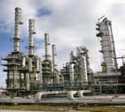
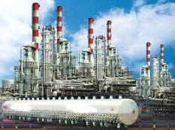
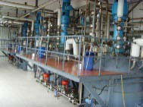
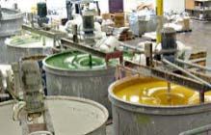
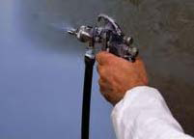
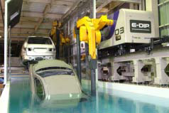
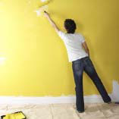
Resins are part of coating systems
Feedstocks
Intermediates
Components
Formulated systems
End uses
Solvents
  Appliances
  Architectural extrusion
  Automotive
  Consumer electronics
  Furniture
  Infrastructure
  Packaging
Basic petro-chemical feedstock
Chemical derivatives
Monomers
Binders
Business to business /
Industrial
Formulator / converter
Cross-linkers
Fine organic chemicals
Business to consumer /
Architect. (DIY)
Additives
Mining and minerals
Inorganic chemicals
Pigments
allnex focus

Slide 2

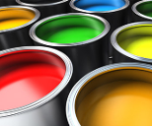











Overview
allnex is a leading producer of resins, additives and crosslinkers for use in various industrial coating resins applications
  LIQUID RESINS & ADDITIVES
  PERFORMANCE RESINS
  RADIATION CURABLE RESINS
  CROSSLINKERS
  POWDER COATING RESINS
Waterborne
PUD, Alkyds, Epoxies, Acrylics
CED Resins
Solventborne
Alkyds, Acrylics, Polyester, SCA
Coating Additives
Urethane Specialties
Oligomers
Urethane Acrylates, Epoxy Acrylates, Polyester Acrylates, Amino Acrylates, UV-PUD
Monomers
UVEKOL® Glass Lamination
VANCRYL® Acrylics
Amino Crosslinkers
Formaldehyde-free Crosslinkers
Phenolic Coating Resins
Technical Phenolics
Polyester Resins
Hybrid, Standard Durable Super Durable
UV Powder Resins
Additives
  Key Technologies
  Automotive and refinish
  Industrial Wood
  Protective & General Metal
  Architectural
  Plastic
  Inks & Overprint Varnishes
  Industrial Wood
  Electronics
  Plastic
  Industrial Wood
  Metal Packaging
  Automotive
  Tires & Rubber Product
  Architectural Extrusions
  Domestic Appliances
  General Metal
  Key Segments
  % of Revenue
  Global player with €2.1 billion annual sales and a leading product portfolio

Slide 3
UV-curable Resins: Formulation Ingredients
Photoinitiators
α cleavable (Norrish Type I): e.g. Irgacure (BASF)
H-abstraction (Norrish Type II): Benzophenone
Accelerators
Amino acrylates
Thiols
Additives
Resin stabilizers
Adhesion promoters
Wetting and flow agents
Fillers
Pigments
http://allnex.com/uveb-curable-resins
Oligomers (Ebecryl®)
Polyester/ether acrylates (e.g. EB800)
Polyurethane acrylates (e.g. EB1291, EB220)
Epoxy acrylates (e.g. EB600)
Reactive Diluents
Diacrylate (HDDA, TPGDA, DPGDA, NGPDA, …)
Triacrylate (TMPTA, PETIA, GPTA, …)
Tetracrylate (PETRA, diTMPTRA, …)

Slide 4
Why Coatings?
Protection
Decoration
Durable properties (hardness, mechanical and chemical resistance → no or slow dynamics, permanent crosslinks)
↕
Dissipative properties (flexibility, adhesion, damping, healing → dynamic network segments)
4

Slide 5
Selection of Hard Coating Precursors
http://allnex.com/uveb-curable-resins
Polyester acrylate: Ebecryl 800 (T_{g,cured} ≈ 86°C)
Epoxy acrylate: Ebecryl 600 (T_{g,cured} ≈ 140°C)
Diluents:
Tripropylene glycol diacrylate – TPGDA (T_{g,cured} ≈ 67°C)
Hexanediol diacrylate – HDDA (T_{g,cured} ≈ 82°C)
Trimethylolpropane triacrylate - TMPTA (T_{g,cured} NA)

