Slide 1



Synthesis and dynamics of double networks
Rowanne Lyons
ESR 2, Université Catholique de Louvain
Supervisors: Charles-André Fustin, Evelyne van Ruymbeke

Slide 2
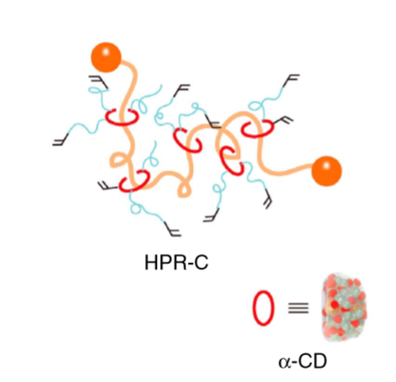
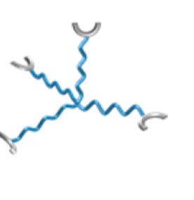
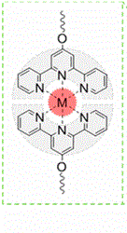
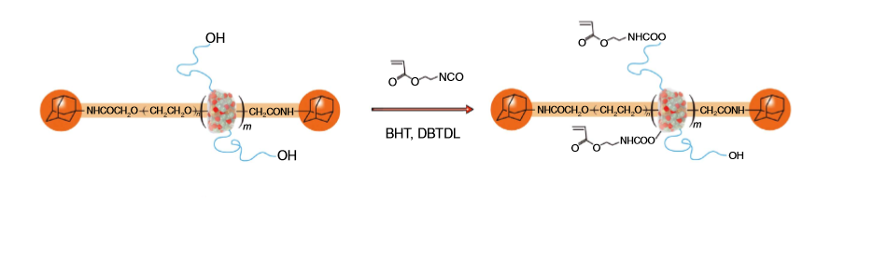

Synthesis of slide ring DDN
or
First network - Metal-terpyridine links
Second network - Slide ring crosslinks
Macromolecules 2017, 50, 5165−5175
Nature Communications volume 5, Article number: 5124 (2014)

Slide 3
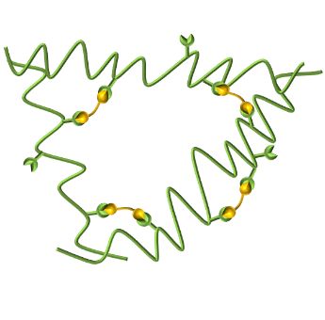

Synthesis of double dynamic network
or
First network - Metal-terpyridine links
Second network – Imine-Aldehyde reversible bonds
Second network - Slide ring crosslinks
Macromolecules 2017, 50, 5165−5175
Nature Communications volume 5, Article number: 5124 (2014)

Slide 4
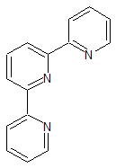

Preparation of linear PnBA of length 25-30K with 6 terpyridine "stickers"
Goal: Unentangled chains with a high concentration of terpyridine stickers
+
=
nBA
Terpyridine acrylate

Slide 5
Preparation of linear PnBA of length 25-30K with 6 terpyridine "stickers"
Ratio Monomer:CTA:AIBN = 200 : 1 : 0.15
Monomer ratio nBA:Terpyridine Acrylate 26 : 1
Polymerisation at 70°C for 3 hours with 20% dioxane as diluent
+
=
nBA
Terpyridine acrylate

Slide 6
Characteristics
GPC
Mn: 31 000g/mol
Mw: 37 000g/mol
D: 1,19
Mass by NMR: 28 000g/mol
6.5 terpyridine groups

Slide 7
Complexation with Zn²⁺
Preparation
  A measured quantity of PnBA was dissolved in a minimum of acetone.
  A measured quantity of ZnCl₂ was dissolved in acetone.
  The two solutions were mixed in the proportions desired 0.5 eq and 1eq of zinc to terpyridine linkers.
  The solvent was removed then the sample was vacuum dried before analysis
Zn²⁺

Slide 8
Rheology
Protocol
  Equilibration of samples at 120° for 15 mins
  Equilibrate sample at 100° for 1-3h, taking a frequency sweep every 30 minutes until measurements stabilise.
  Repeat for further temperatures to -20°

Slide 9
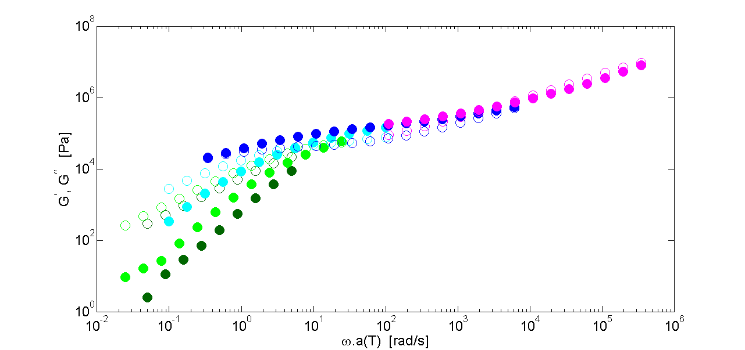
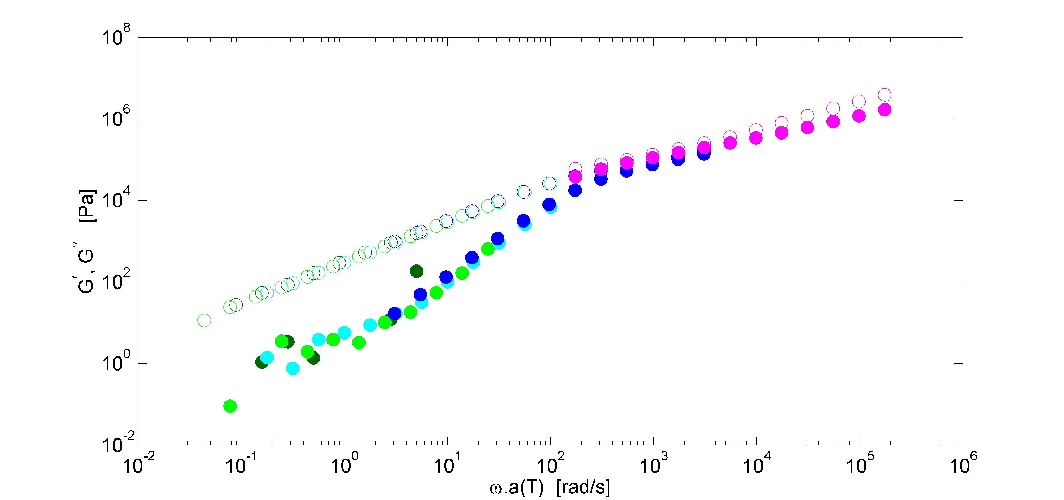
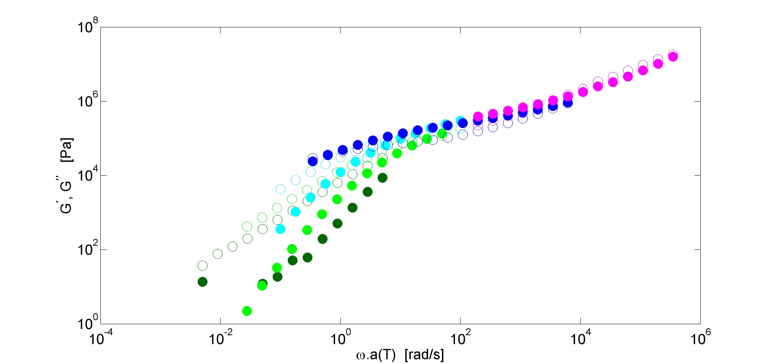
Effect of amount of Zn²⁺ crosslinker – Master Curves
Zn 0.5 eq
ref
Zn 1 eq
Using the shift factors for pure PnBA do not work when the polymer is complexed with Zn

Slide 10
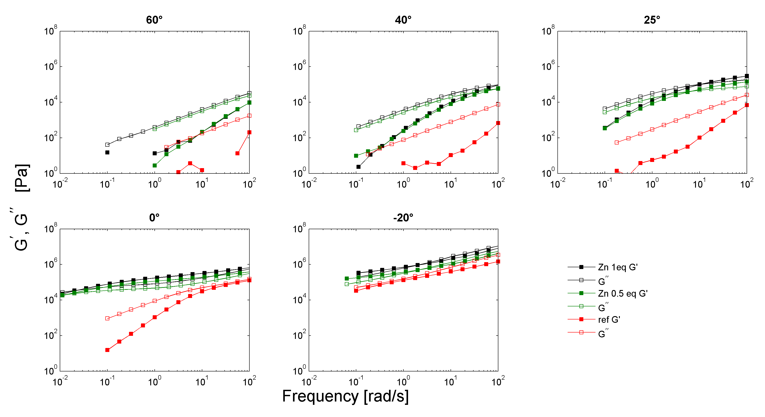
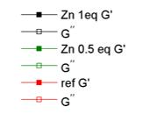
Effect of amount of Zn²⁺ crosslinker
Very similar values of G’ and G” for complexes with 0.5 eq and 1 eq of Zn
Plateau at 0° and -20° due to sticker association

Slide 11
DSC

Slide 12
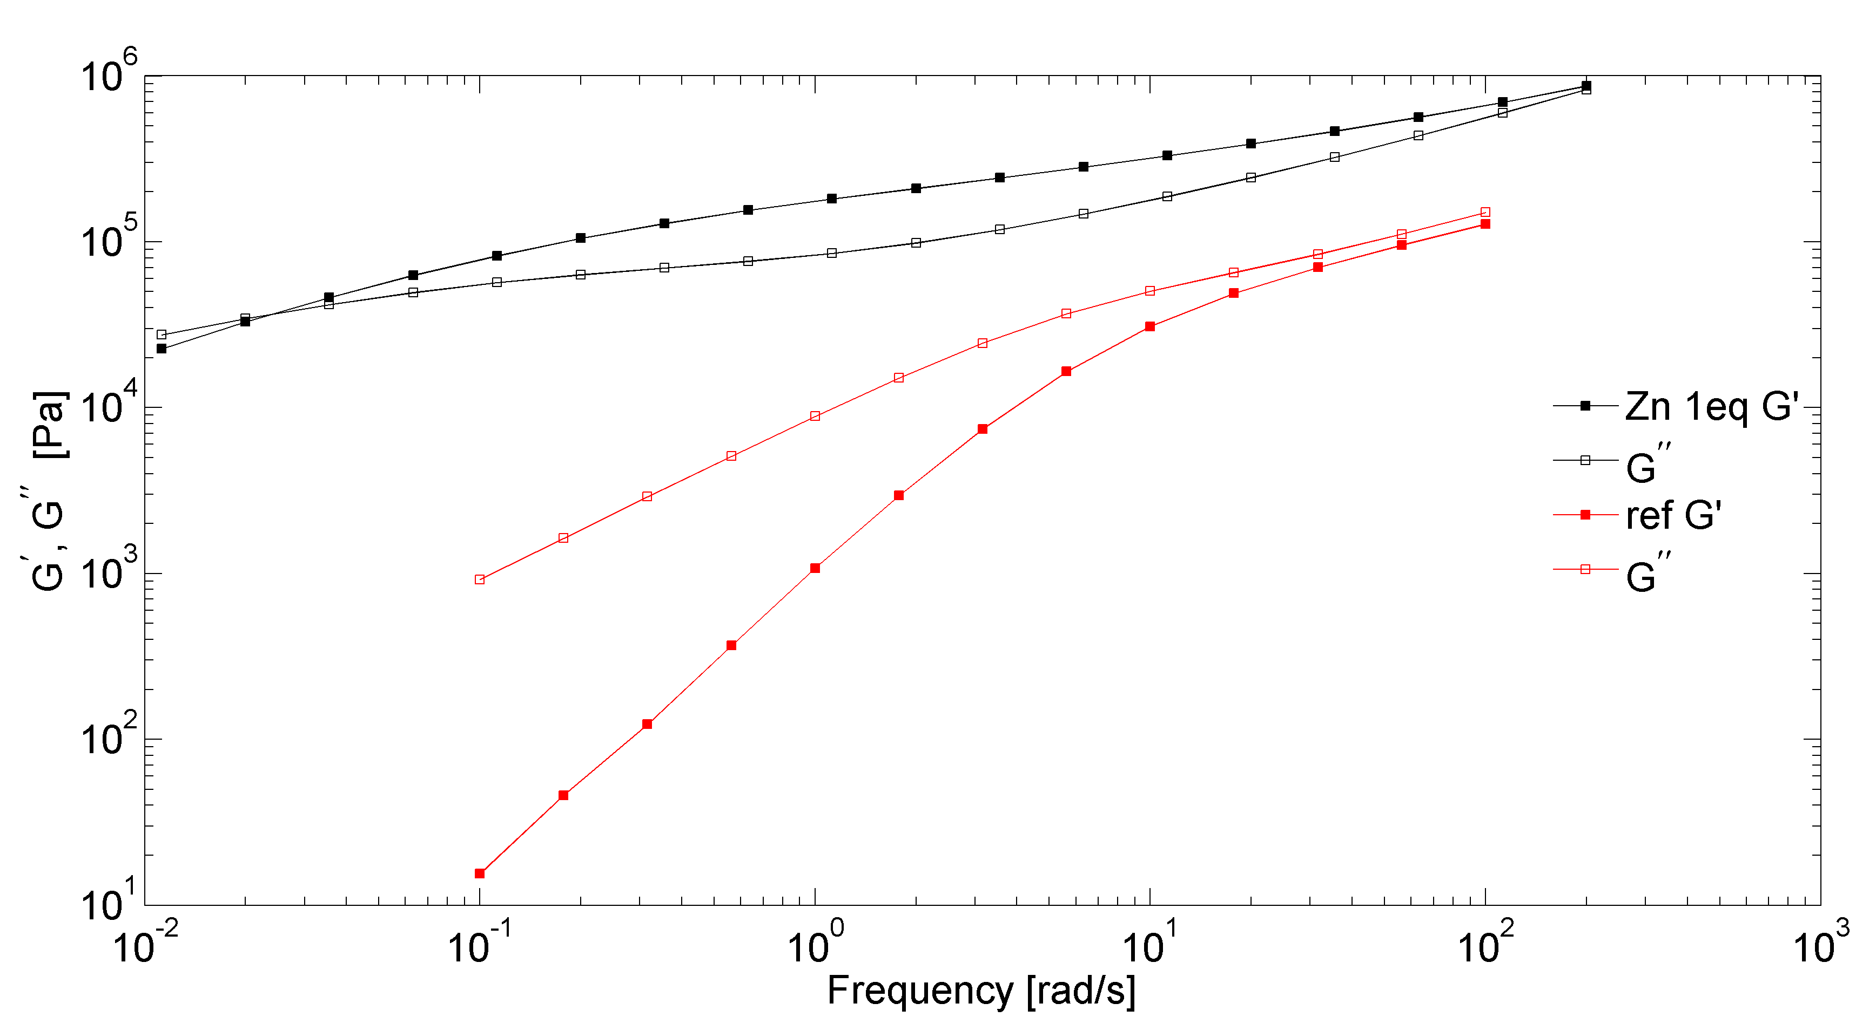
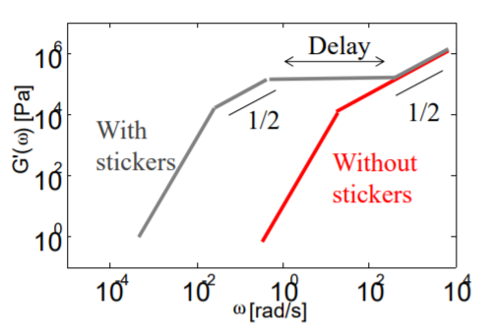
Sticky Rouse Model
1/2
1/2
1/2
As compared to the uncomplexed PnBA 25K sample, with 1 eq of Zn, the relaxation of the chains is delayed by the association of the stickers.
≈ τ⁻¹_{sticker}

Slide 13
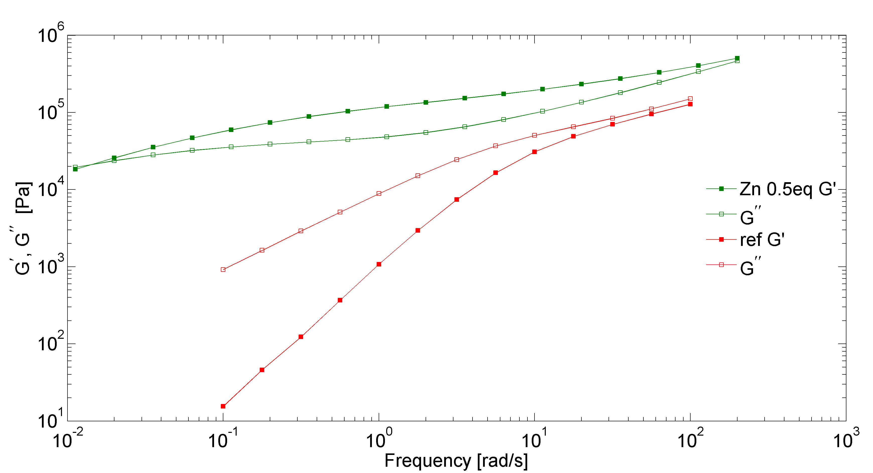
Sticky Rouse Model
1/2
1/2
1/2
τ⁻¹_{sticker}

Slide 14
Comparison with PnBA102K 14 terpy
Unentangled
1 sticker per 4000g/mol
Entangled
1 sticker per 7000g/mol

Slide 15
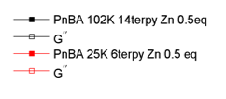
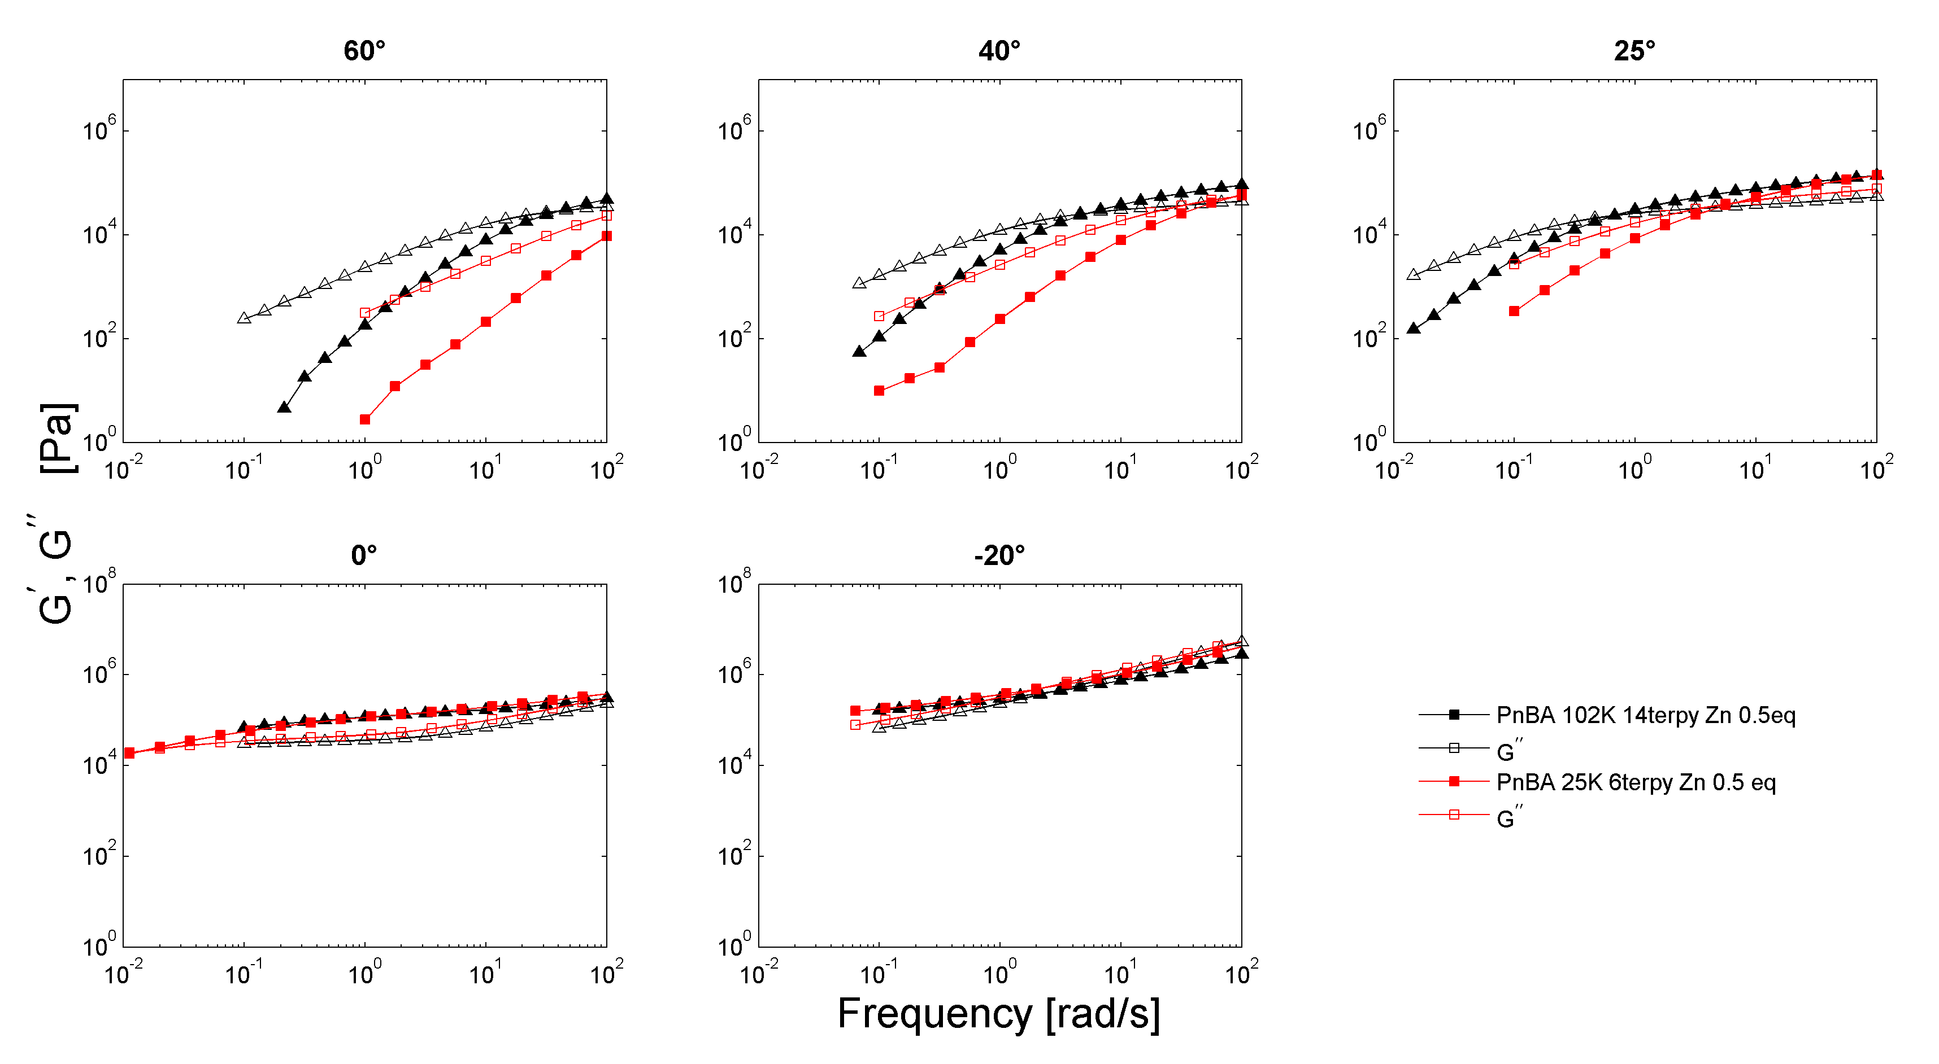
Comparison with PnBA102K 14 terpy Zn 0.5 eq
PnBA 102K shows the plateau of an entangled polymer, while unentangled PnBA 25K relaxes more quickly
At 0° and -20°C, the curves are superimposable as the effect of the stickers makes up for the lack of entanglements

Slide 16
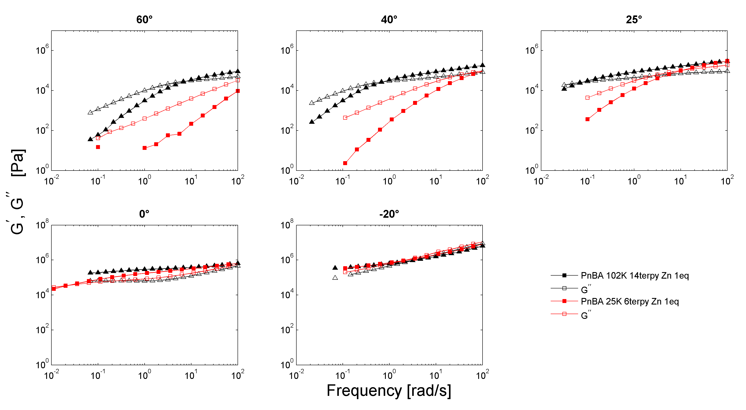
Comparison with PnBA102K 14 terpy Zn 1 eq
Trend continues as seen with Zn 0.5 eq

Slide 17
PnBA 473K reference
M_{n}¹⁾ [kDa] | PDI | DP_{n} | f [%] | N_{f} | Eq (CL) | N_{CL} | f _{CL} [%] | m [g] | T_{g}²⁾ [ºC]
473 | 1.94 | 3600 | 0.5 | 18 | 4.5 | 9 | 50 | 3.50 | -47

Slide 18
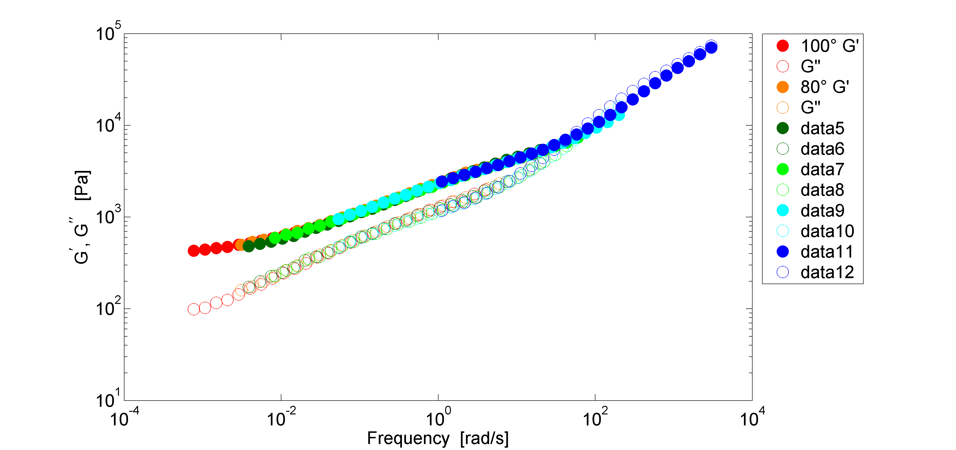
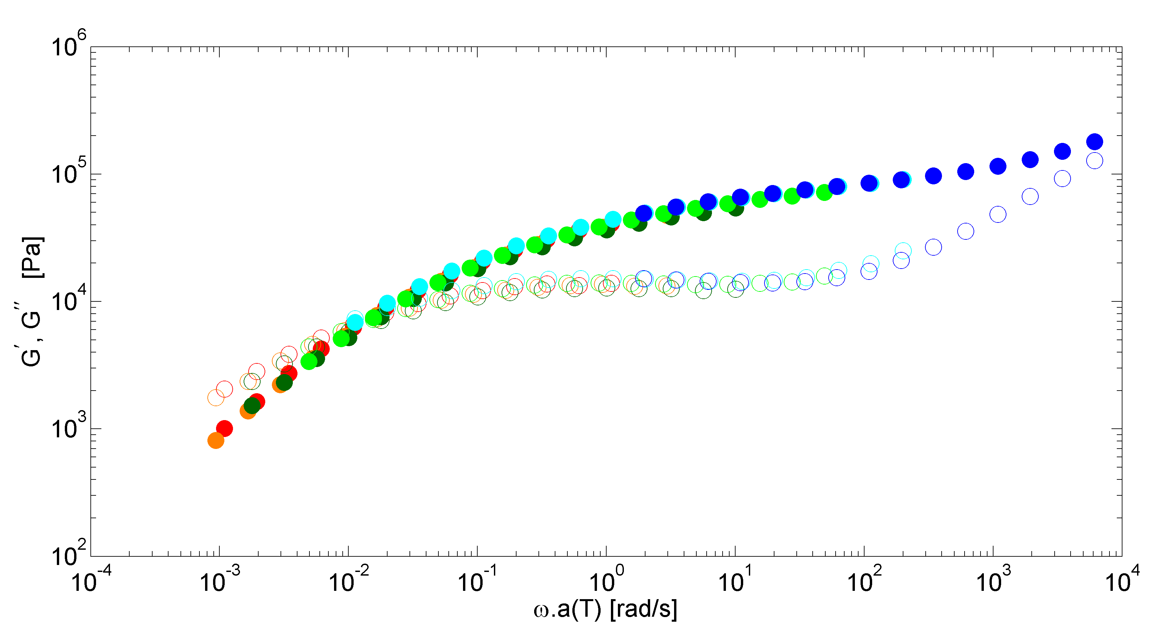
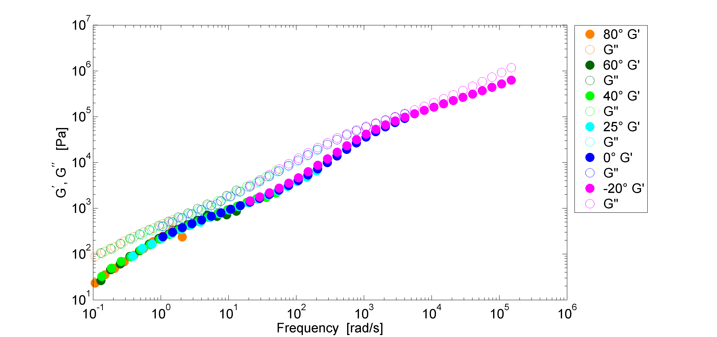
PnBA 473K reference
Entangled polymer with rubbery plateau due to entanglements and relaxation to liquid state at T>80°

Slide 19
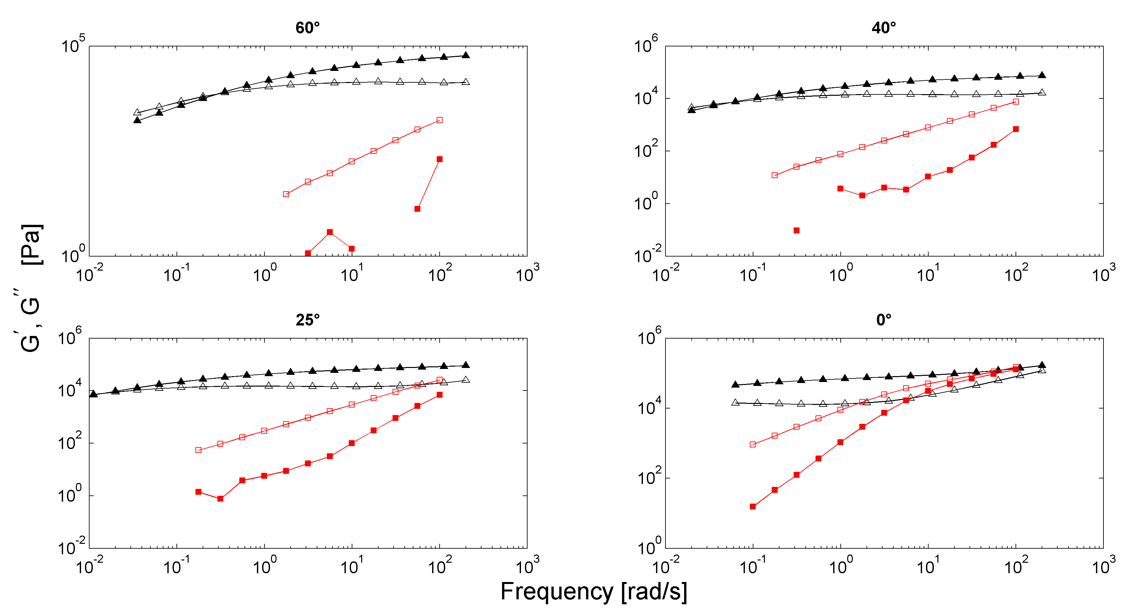
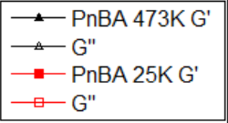
PnBA 473K compared to PnBA 25K
As compared to PnBA 22K, PnBA 473K does not fully relax at low temperatures, due to entanglements from the very long chains

Slide 20
PnBA473K crosslinked 50%
Preparation
  The polymer precursor was dissolved in THF (concentration = 1g/10mL)
  The imine crosslinker was dissolved in THF (10mg/mL) and the amount corresponding to 50% functionality was added via micropipette
  The THF was allowed to slowly evaporate at room temperature over a few days
  The sample was then heated in the vacuum oven at 110°C overnight.

Slide 21
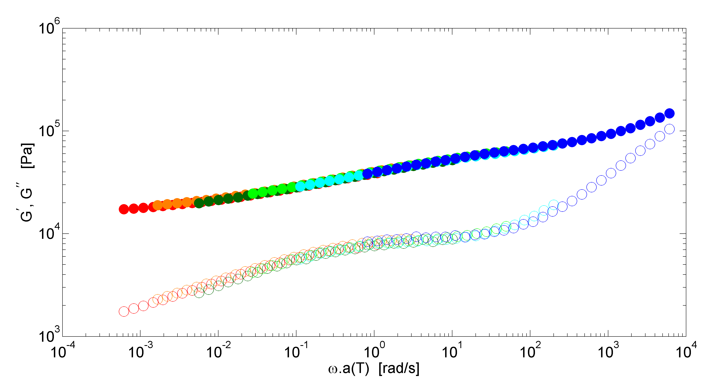
PnBA 473K crosslinked 50%
When crosslinked, the sample does not relax at high temperatures
To reduce the effect of entanglements in the double network, it should be diluted

Slide 22
PnBA 22K
GPC
Mn: 22 000g/mol
Mw: 26 000g/mol
D: 1,19

Slide 23
Imine-aldehyde network diluted in PnBA22K
Preparation
  The polymer precursor, along with PnBA22K was dissolved in THF (concentration = 1g/10mL).
  The imine crosslinker was dissolved in THF (10mg/mL) and the amount corresponding to 50% functionality was added via micropipette
  The THF was allowed to slowly evaporate at room temperature over a few days
  The sample was then heated in the vacuum oven at 110°C overnight.

Slide 24
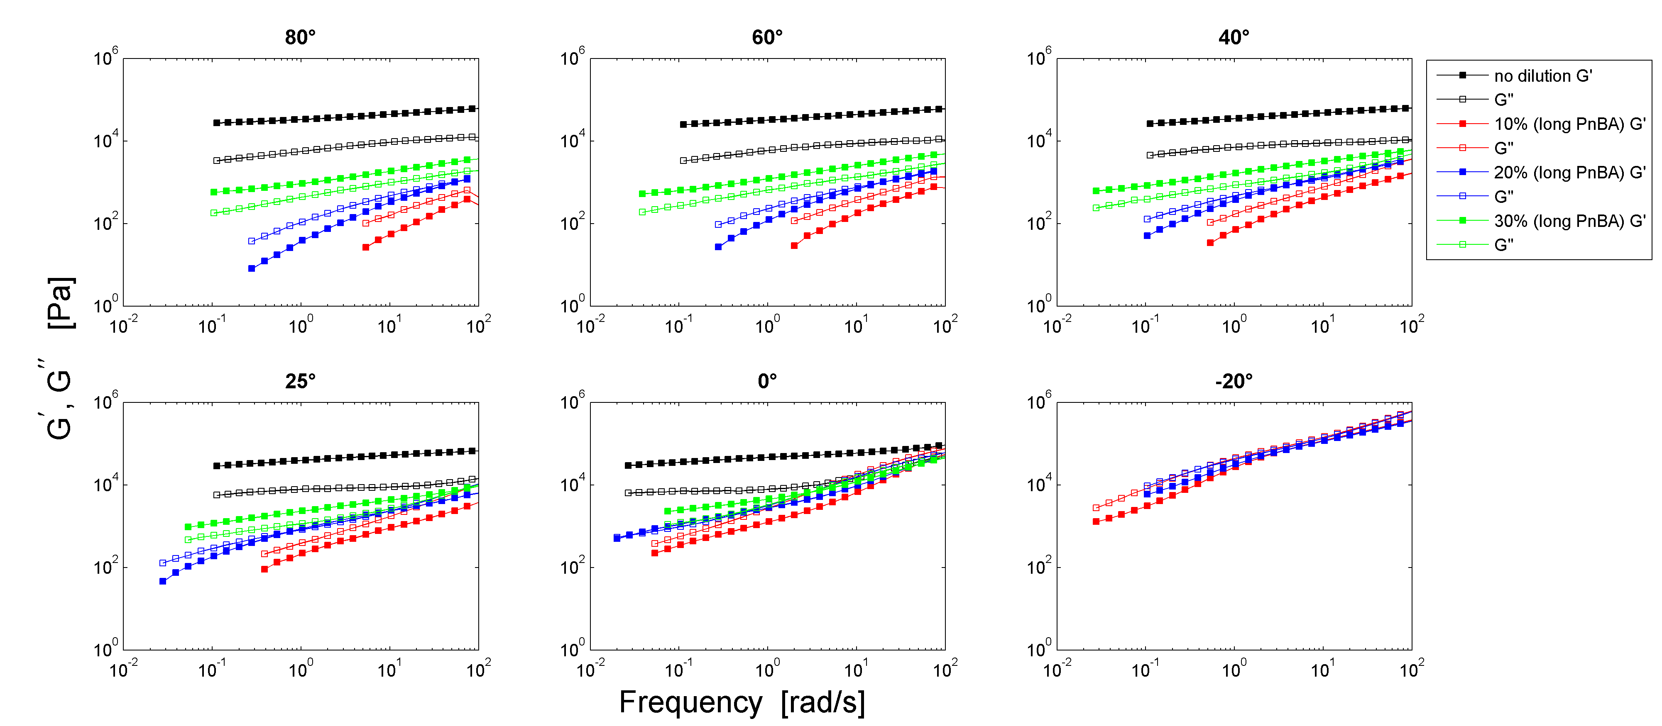
Imine-aldehyde network diluted in PnBA22K
Dilution to ~10³ Pa from 5.10⁴ Pa

Slide 25
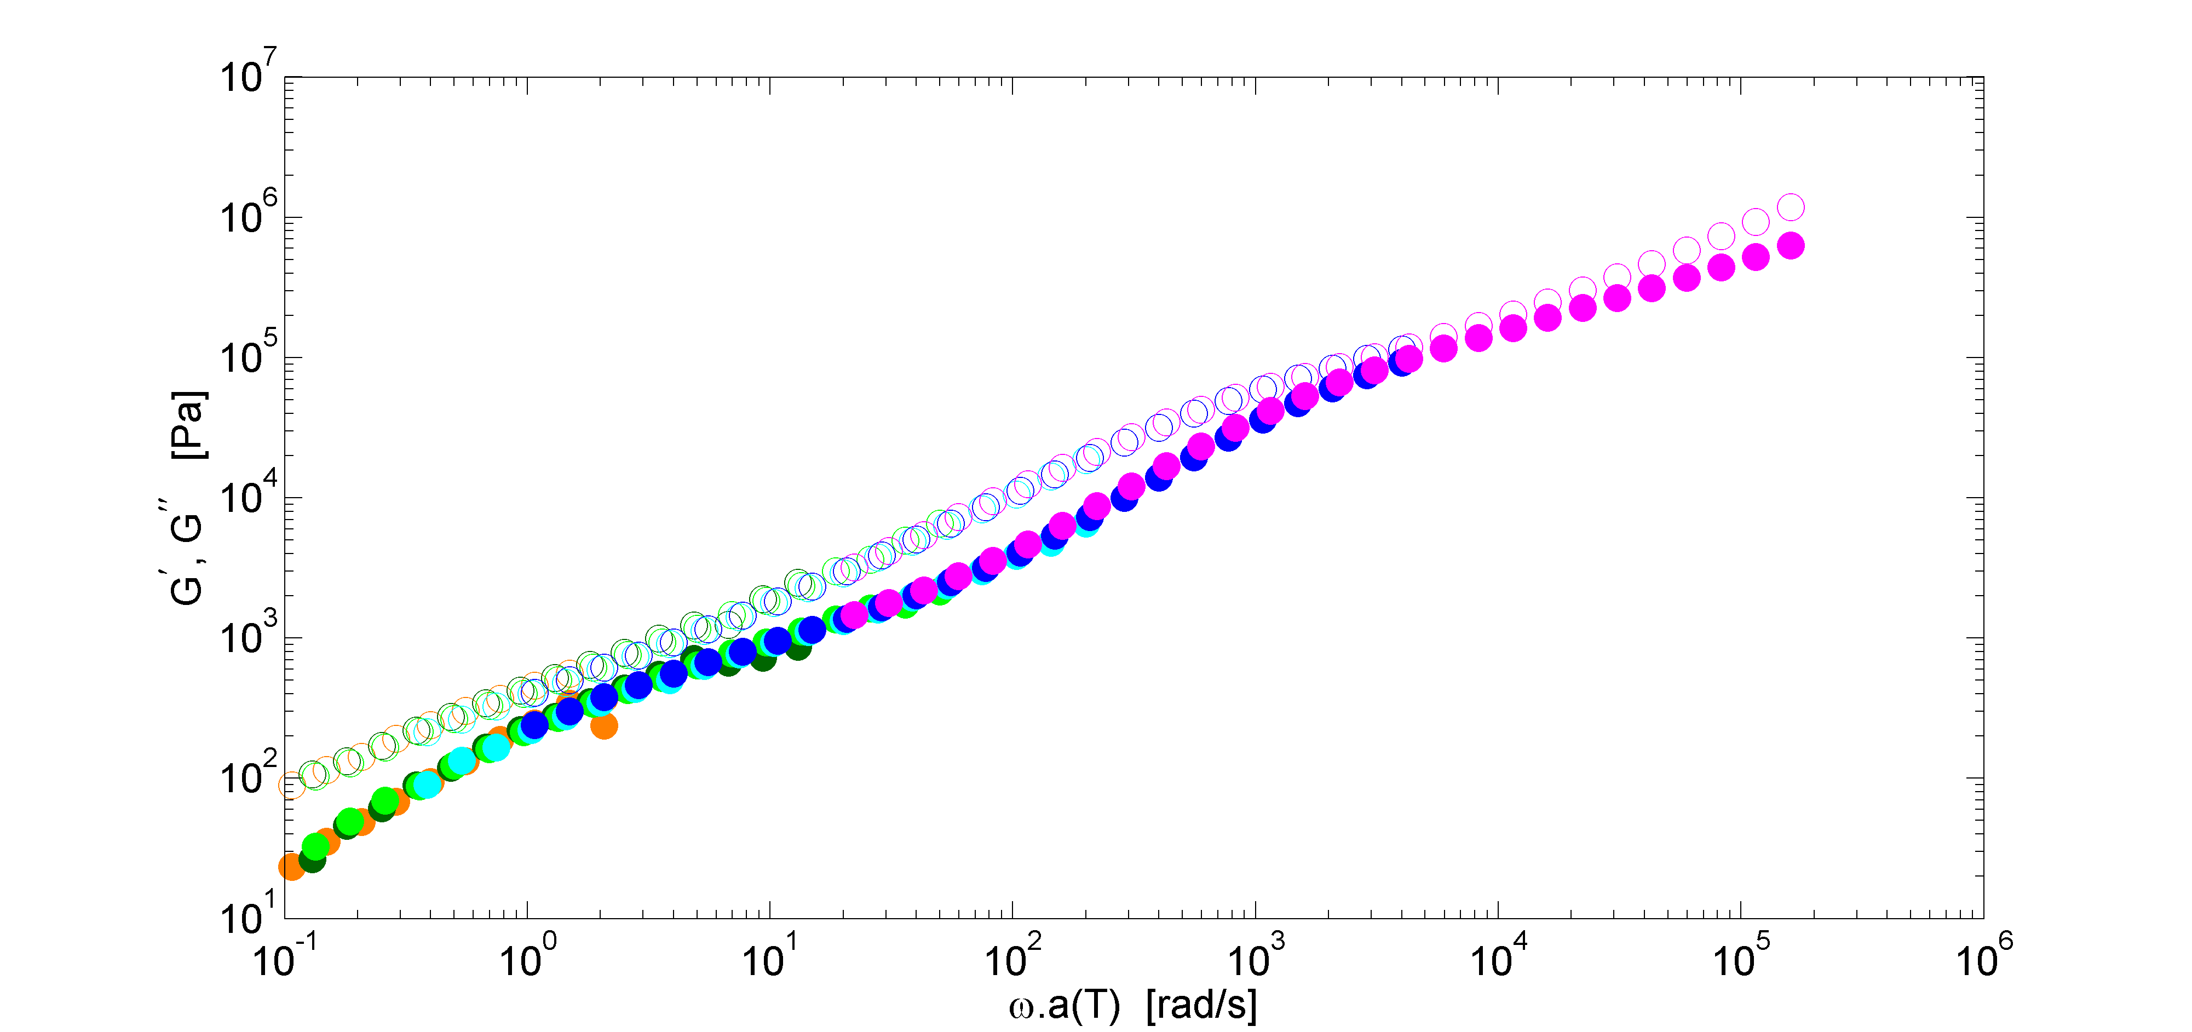
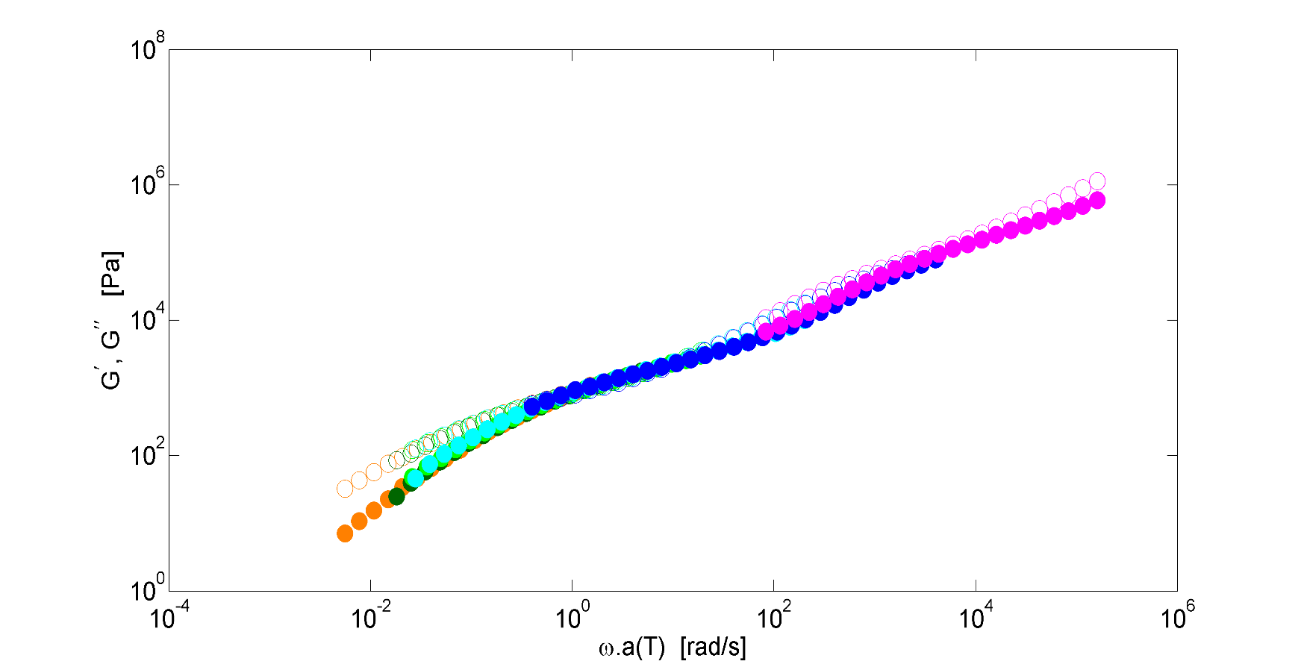
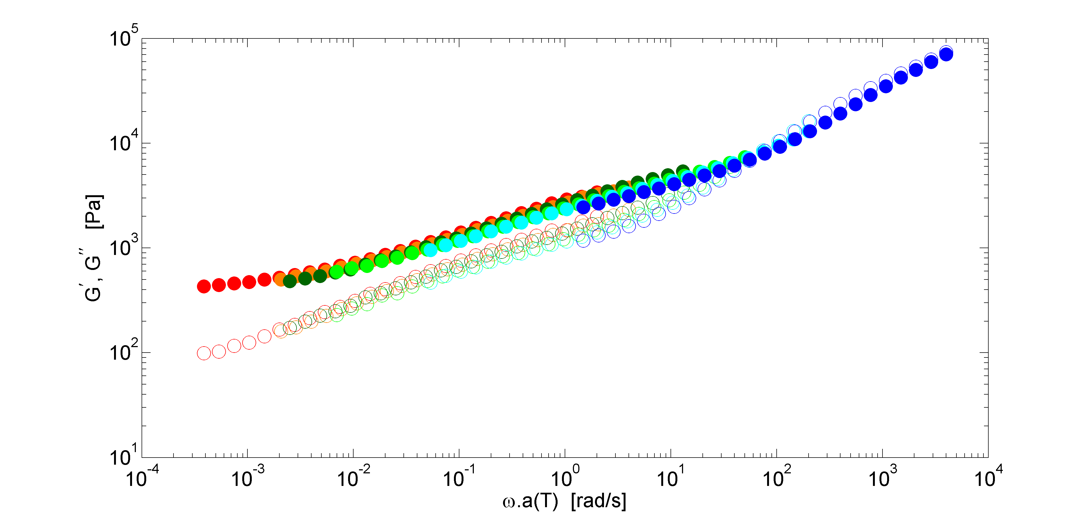
Imine-aldehyde network diluted in PnBA22K – revised shift factors
10% dilution
20% dilution
30% dilution
10% dilution – two relaxations due to component polymer chains
30% dilution – the plateau at low frequencies shows the successful crosslinking reaction

Slide 26
Conclusion
The synthesis and rheological analysis of linear unentangled PnBA chains with terpyridine stickers was realised.
The effect of the high concentration of stickers when complexed with Zn²⁺ ions at low temperatures was comparable to an entangled linear PnBA sample with less stickers.
A long chain PnBA with sparse associating sites was diluted in the unentangled PnBA and crosslinked successfully via imine-aldehyde bonds.

Slide 27
Next Steps
Combining the imine-aldehyde network with PnBA chains complexed with zinc
Measuring the T_{g} of different concentrations of Zn
Measuring PnBA chains with a higher concentration of terpyridine stickers

Slide 28
Thank You

